Slide 1


Learning Structural Dynamics with GNN
Department of Mathematics
Computational Science Engineering
Mingyuan Chi
Semester Project
12. 01 2024, Zürich

Slide 2
Introduction
FEM
Message passing
Equivalence
Dirichlet Boundary
Notes:
Add figures/images
Introduction

Slide 3
Introduction
Contribution
- Introduction Static Condensation Equivelant Architecture (SCEA) for modeling the Dirichlet boundary condition in the FEM problem.
- Development of Galerkin Equivalent Architecture (GEA), which takes several forms including the local pseudo linear, local pseudo bilinear, and global version.
- Extensive experimentation to analyze the relation between the observation ratio and the precision of the model for various scenarios(invariant, boundary-variant, and force-variant), in which could we visualize the generalization competence for physical loss.
- Proposal of a fast and differentiable assemble method representing the assemble step in FEM as sparse-dense tensor multiplication.

Slide 4
Background
Element Graph
Vertice Graph

Slide 5
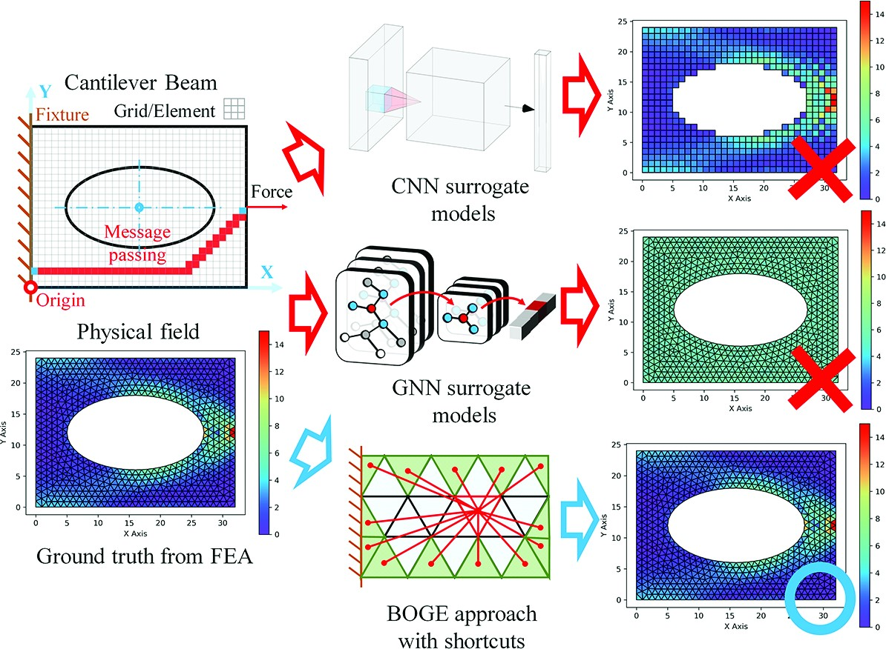
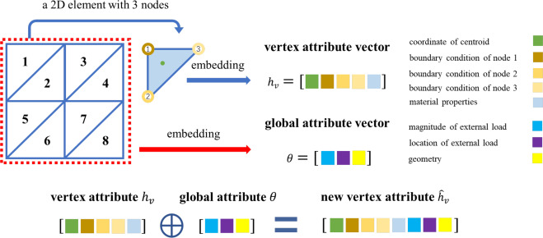
Background
Element Graph
Jiang C, Chen N Z. Graph Neural Networks (GNNs) based accelerated numerical simulation[J]. Engineering Applications of Artificial Intelligence, 2023, 123: 106370.
Fu X, Zhou F, Peddireddy D, et al. An finite element analysis surrogate model with boundary oriented graph embedding approach for rapid design[J]. Journal of Computational Design and Engineering, 2023, 10(3): 1026-1046.
Notes:
There are many works on the element graph. I picked out two of them.
For the first one, they encode the boundary information, node coordinate, external force as well as material properties into node feature
For the second one, to handle the Dirichlet boundary condition, they use a fully connected bi-partite graph.
They connect each boundary element with each inner elements.

Slide 6
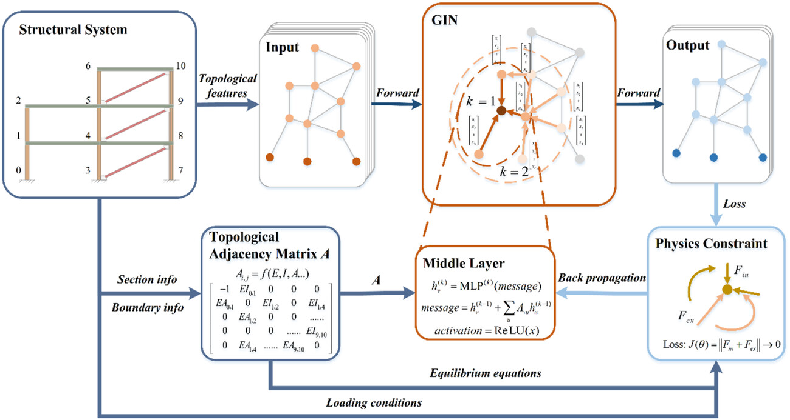
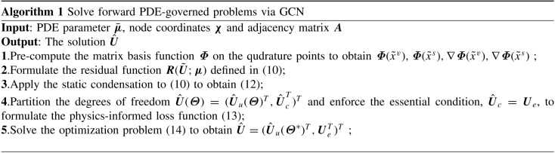
Background
Vertice Graph
Song L H, Wang C, Fan J S, et al. Elastic structural analysis based on graph neural network without labeled data[J]. Computer‐Aided Civil and Infrastructure Engineering, 2023, 38(10): 1307-1323.
Gao H, Zahr M J, Wang J X. Physics-informed graph neural Galerkin networks: A unified framework for solving PDE-governed forward and inverse problems[J]. Computer Methods in Applied Mechanics and Engineering, 2022, 390: 114502.
Notes:
As for the vertice graph.
The first work focus mainly on the truss dataset, which can be easily converted to graph. Since the vertice graph is more close to the form of the linear elasiticity, they could compute the physical loss by computing the difference between the left and right side of the linear system.
The second work is more generalized, it could be applied to any element mesh, for example, the triangle mesh and the tetrahedron mesh. They use a weak form physical loss to compute the residual from the prediction of the gnn model. For the Dirichlet boundary condition, they simply set the boundary prediction to 0 for zero boundary.

Slide 7
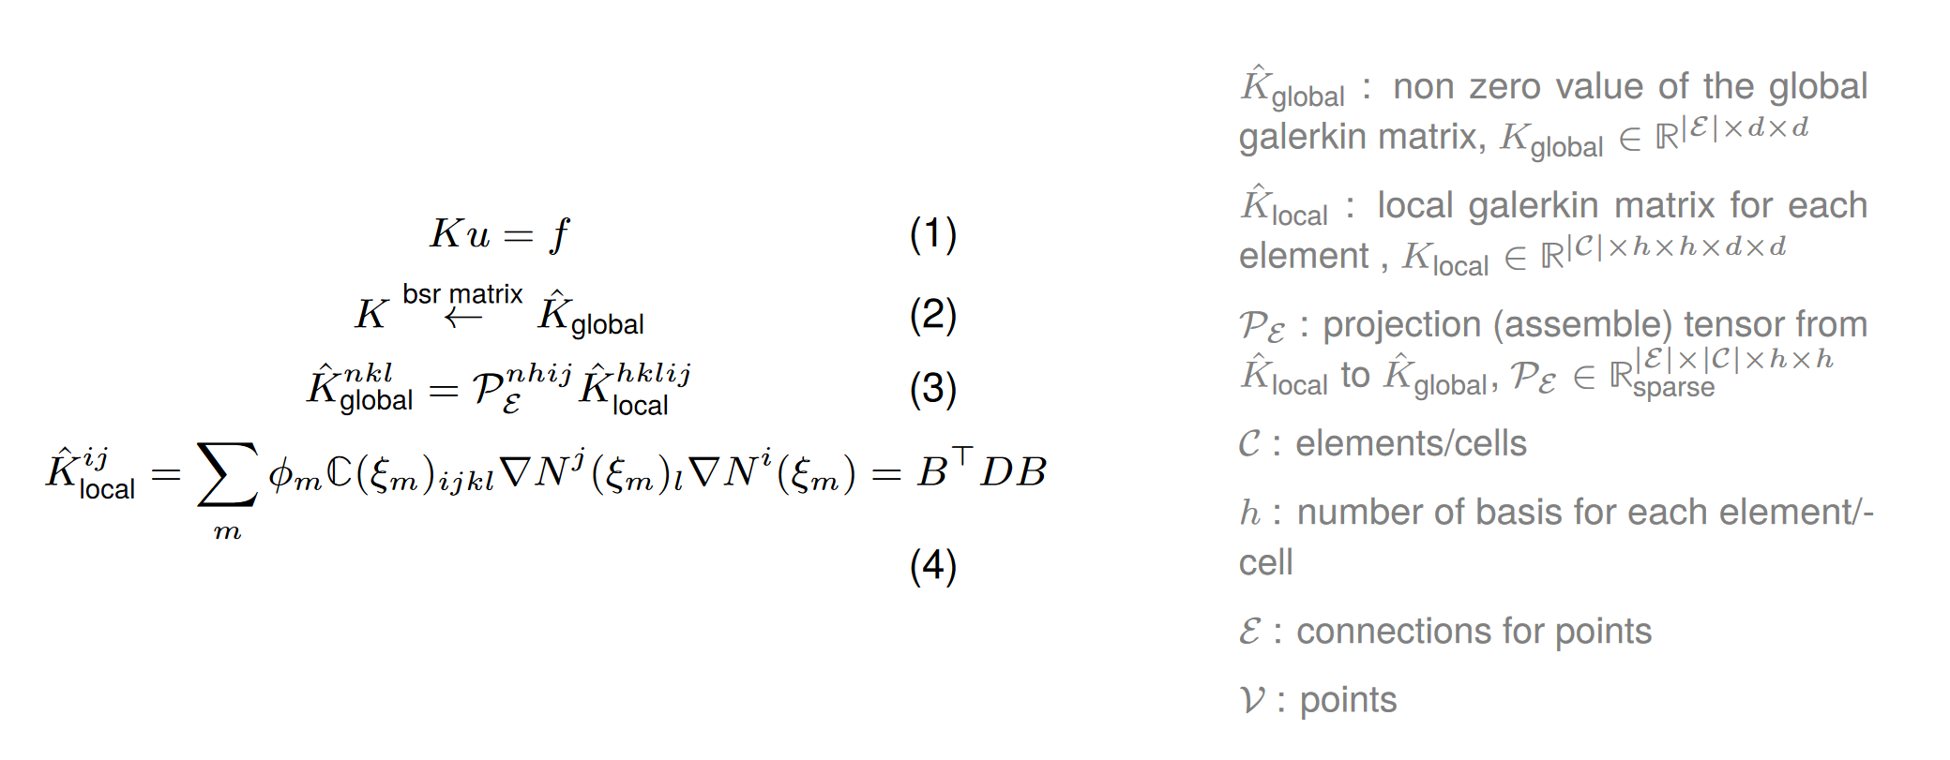
Background
Linear Elasticity

Slide 8
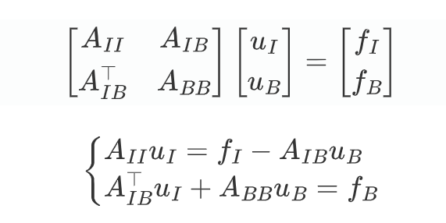
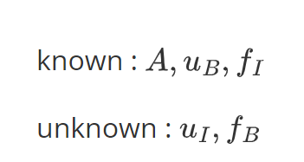








Background
Static Condensation
$$A_{II}$$
$$A_{IB}$$
$$u_{I}$$
$$f_{I}$$
$$A_{BI}$$
$$A_{BB}$$
$$u_{B}$$
$$f_{B}$$

Slide 9
Methodology
Fast Assemble
Notes:
Fast and differentiable assemble method
Example

Slide 10

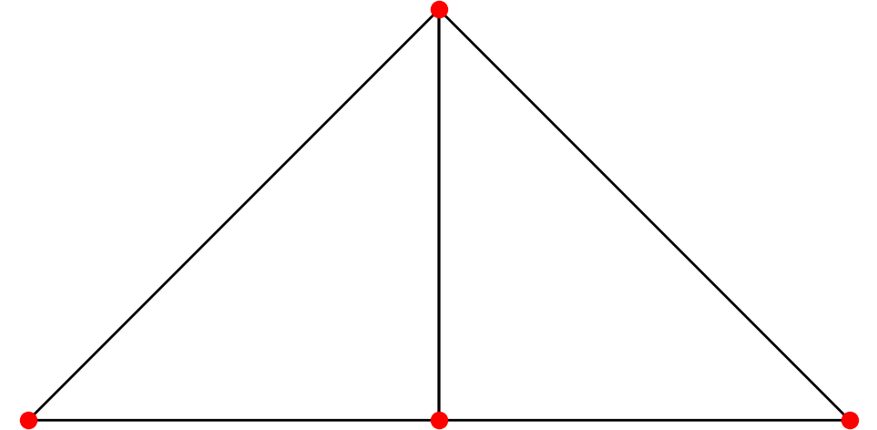
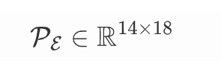
Methodology
Fast Assemble
Notes:
Fast and differentiable assemble method
Example

Slide 11
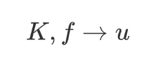
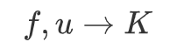
Methodology
FEM
MPNN
Reverse Problem
Forward Problem
Static Condense Equivalent Architecture(SCEA)
Galerkin Equivelant Architecture (GEA)
Notes:
Fast and differentiable assemble method
Example

Slide 12
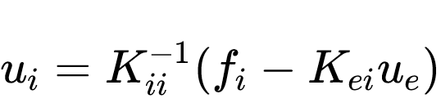
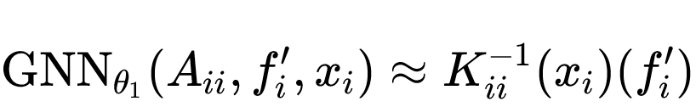
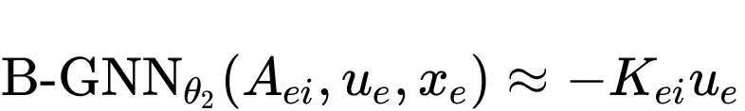
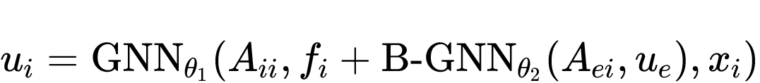
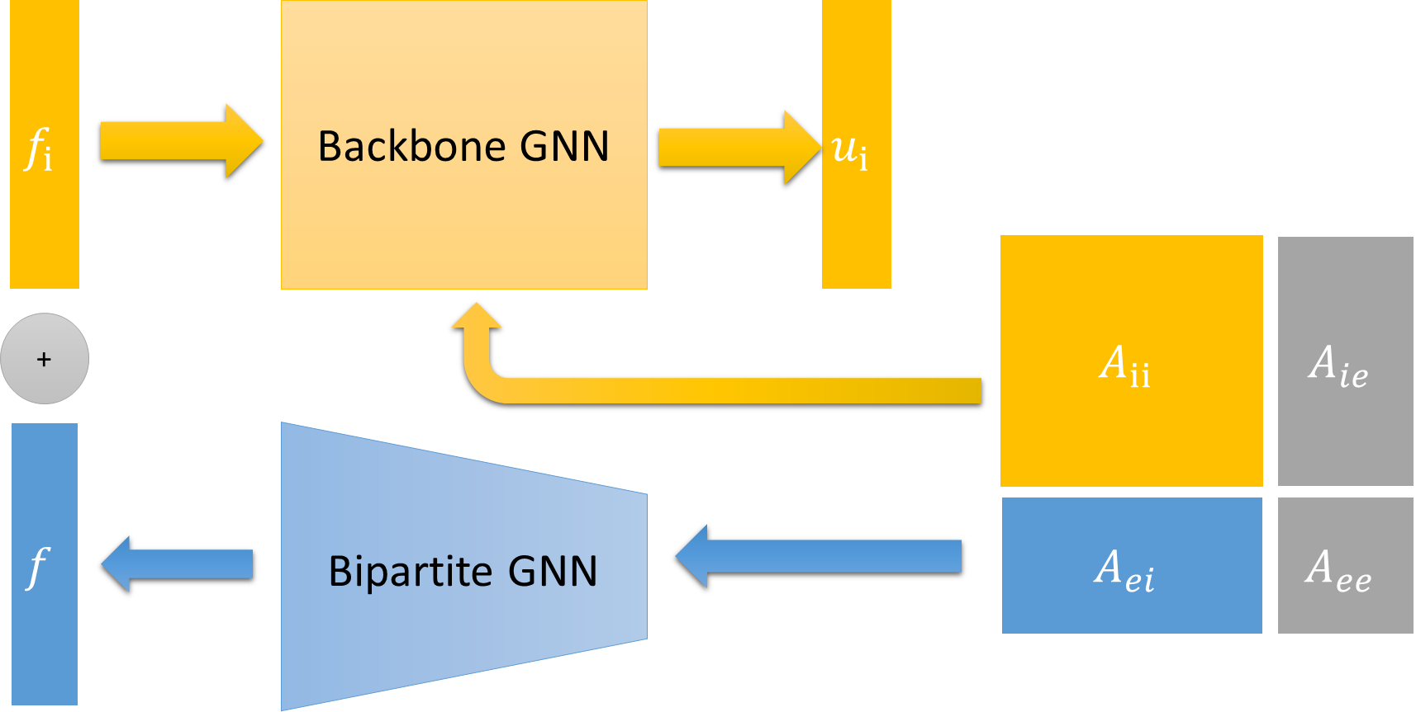
Methodology
Static Condense Equivalent Architecture(SCEA)
Notes:
Biparitte Graph Definition and Example
Bipartite GNN detail

Slide 13
Methodology
Static Condense Equivalent Architecture(SCEA)
Message propagate
MLP
MLP
BiParite - GNN
Notes:
Biparitte Graph Definition and Example
Bipartite GNN detail

Slide 14
Methodology
Static Condense Equivelant Architecture(SCEA)
50% nodes Test (data)
50% nodes Test (data)
50% nodes Valid (data)
50% nodes Valid (data)
100% nodes Train (phy)
100% nodes Train (phy)
graph
graph1 | graph2 | graph3 | graph4 | graph5 | graph6

Slide 15
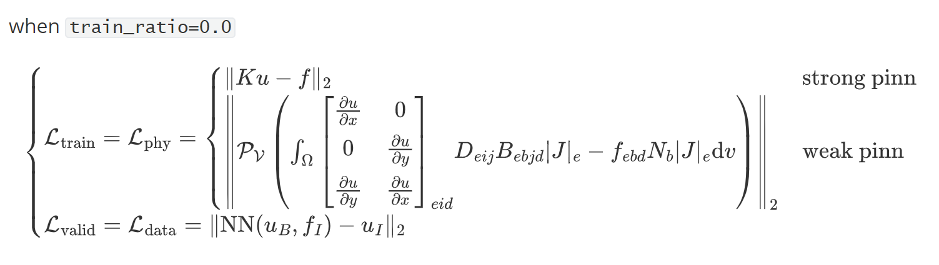
Methodology
Static Condense Equivelant Architecture(SCEA)

Slide 16
Methodology
Static Condense Equivelant Architecture(SCEA)
Notes:
+ Experiments Directly

Slide 17
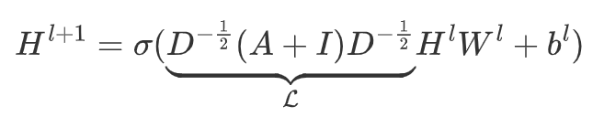
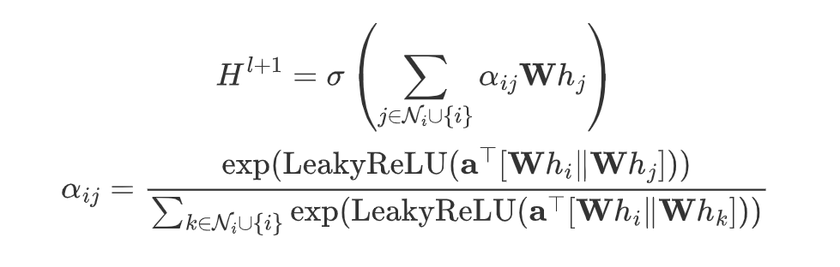
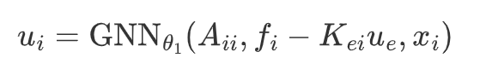
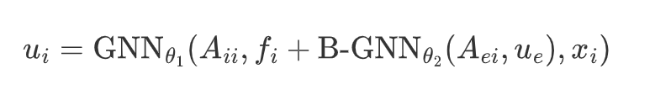
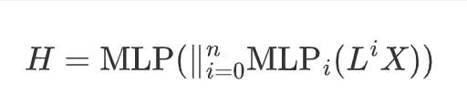
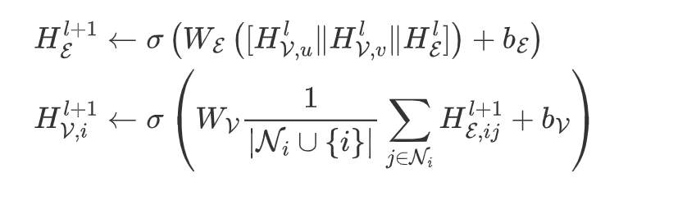
Experiments
Static Condense Equivelant Architecture(SCEA) : Baselines
Baselines
Condense Type
none:
DBC added to training set (data loss)
GCN:
GAT:
static:
nn:
SIGN:
Node-Edge GNN:

Slide 18
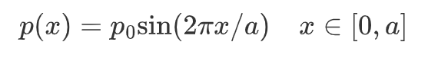
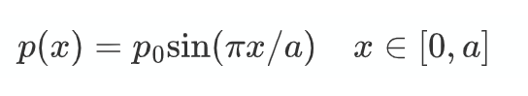
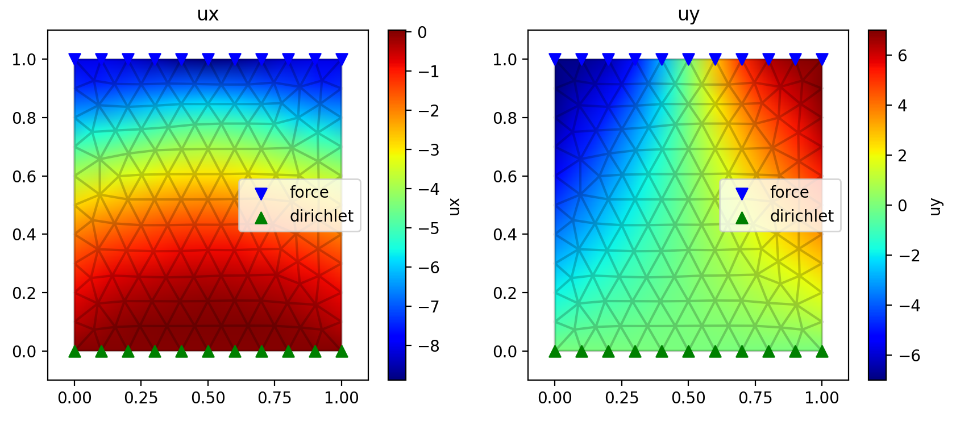
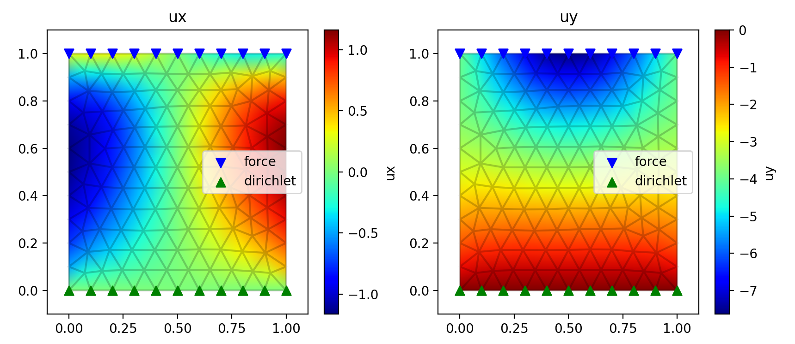
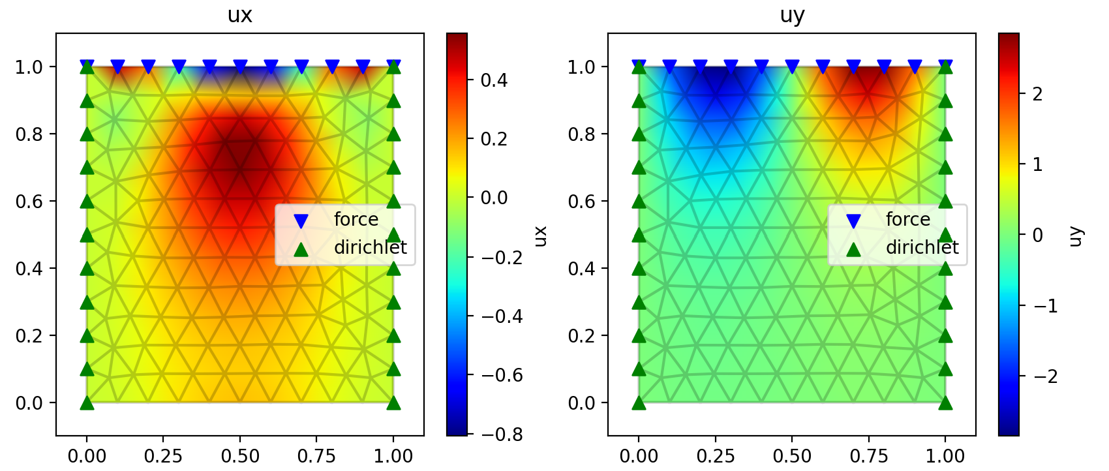
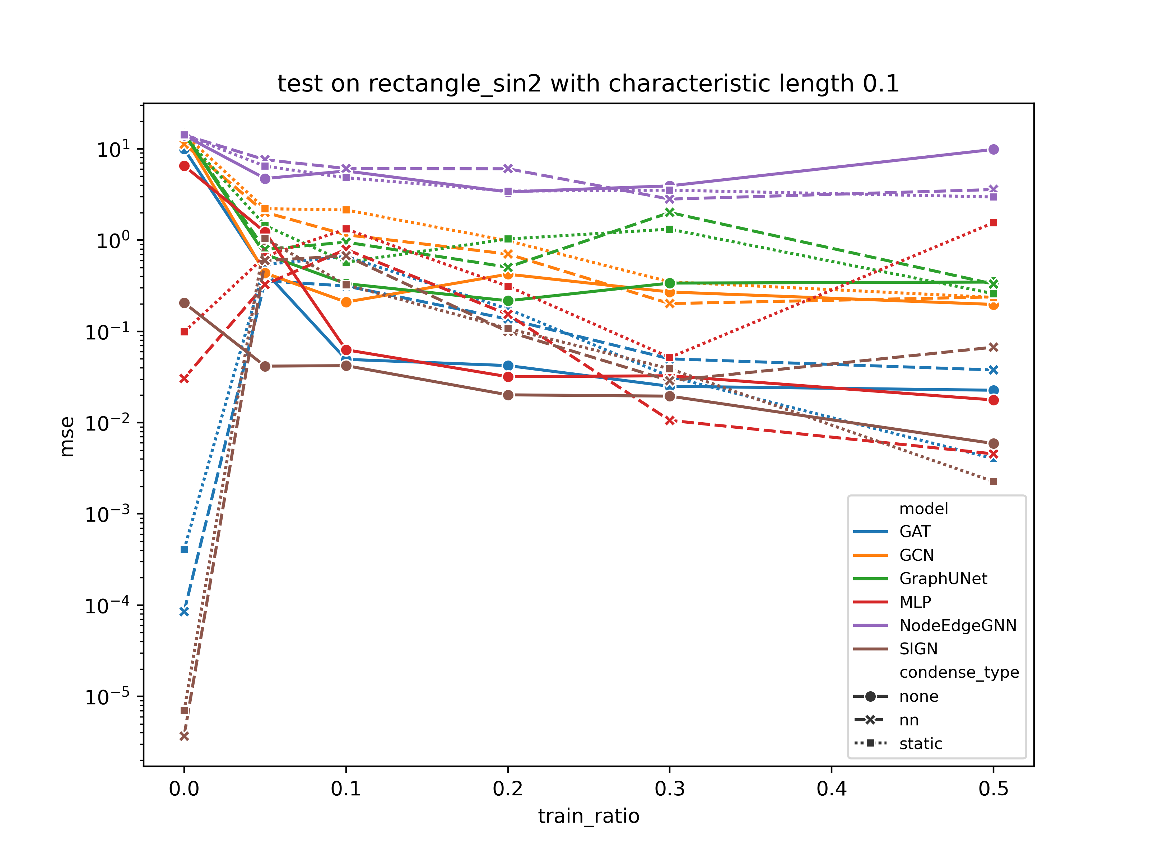
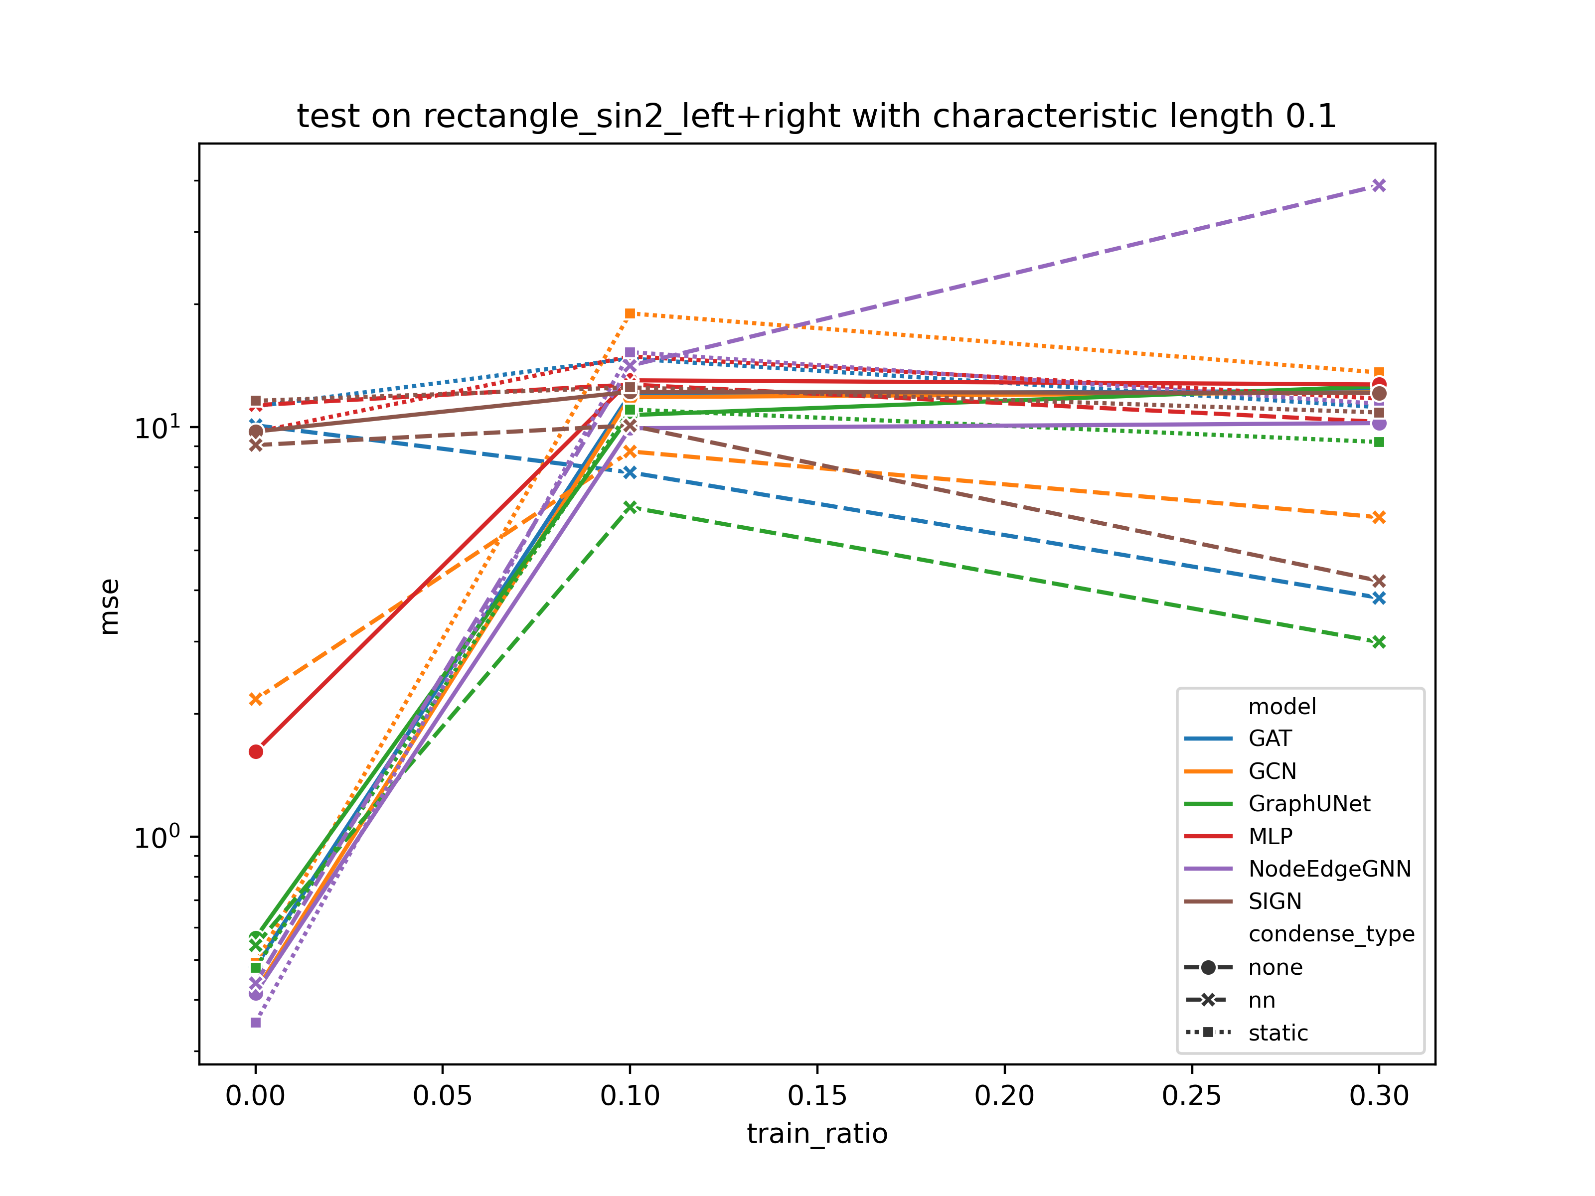
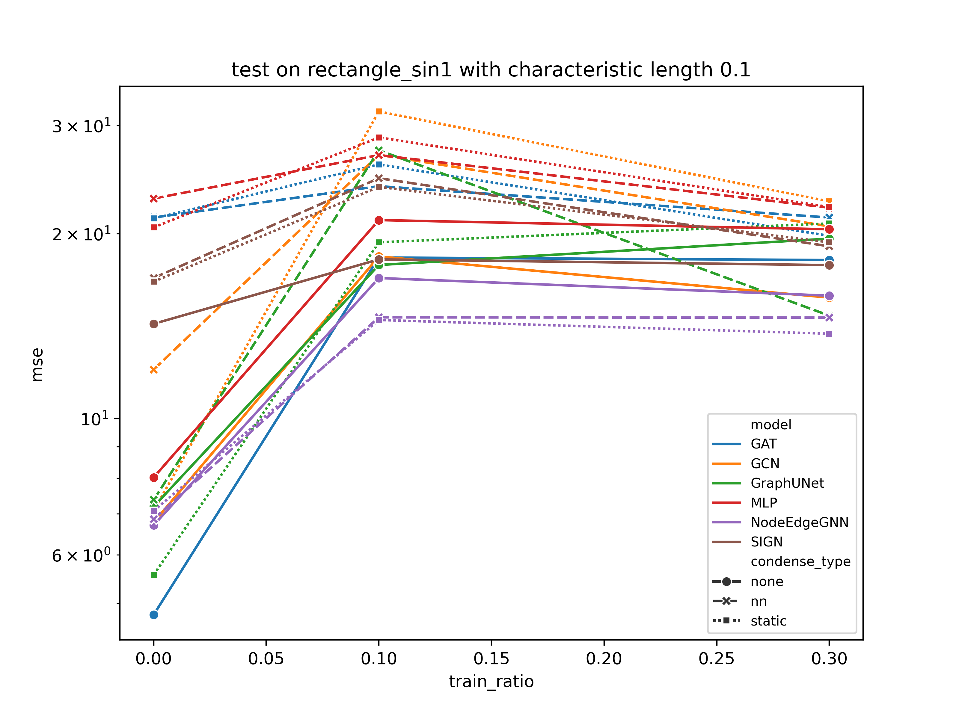
Experiments
Static Condense Equivelant Architecture(SCEA) : Dataset
Notes:
Low is better, minimize MSE loss
Different training ratio

Slide 19
Experiments
Static Condense Equivelant Architecture(SCEA) : Dataset

Slide 20
Experiments
Static Condense Equivelant Architecture(SCEA) : Dataset

Slide 21
Experiments
Static Condense Equivelant Architecture(SCEA) : Dataset

Slide 22
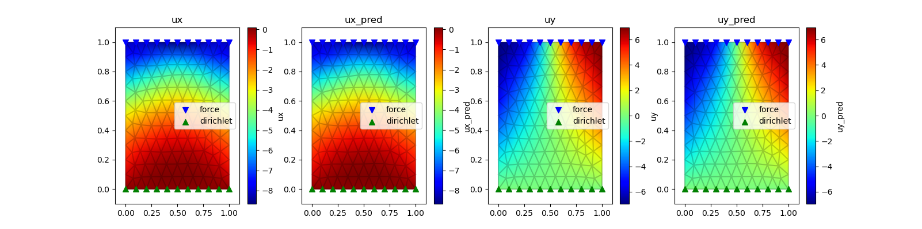
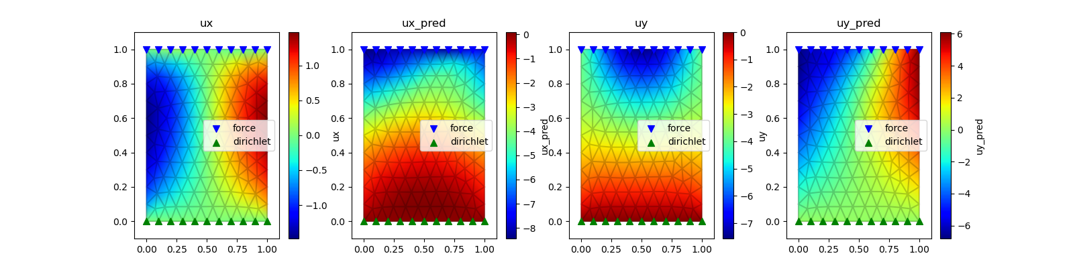
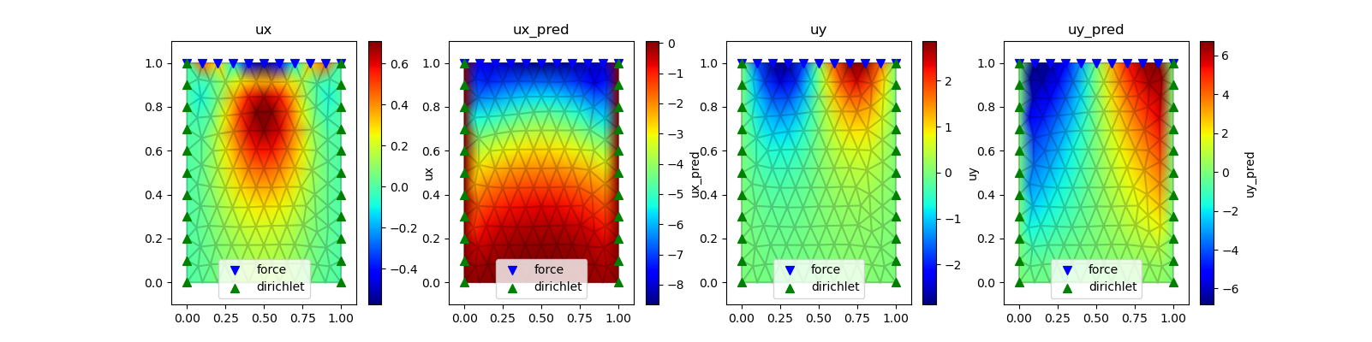
Experiments
Static Condense Equivelant Architecture(SCEA) : Case Study
0.0train ratio
+ SIGN(8 hops)
+ auto weight
+ strong form
Training dataset is good, other dataset is not
One-shot is not good at generalization

Slide 23
Experiments
Static Condense Equivelant Architecture(SCEA) : Summary
SIGN/GAT + static/nn condense performs best on fully phy loss
Phy loss tend to overfit, and remember the coordinate mapping to displacement
Frequency Variant performance is better than Boundary Variant
Notes:
In detail
SIGN is better?

Slide 24
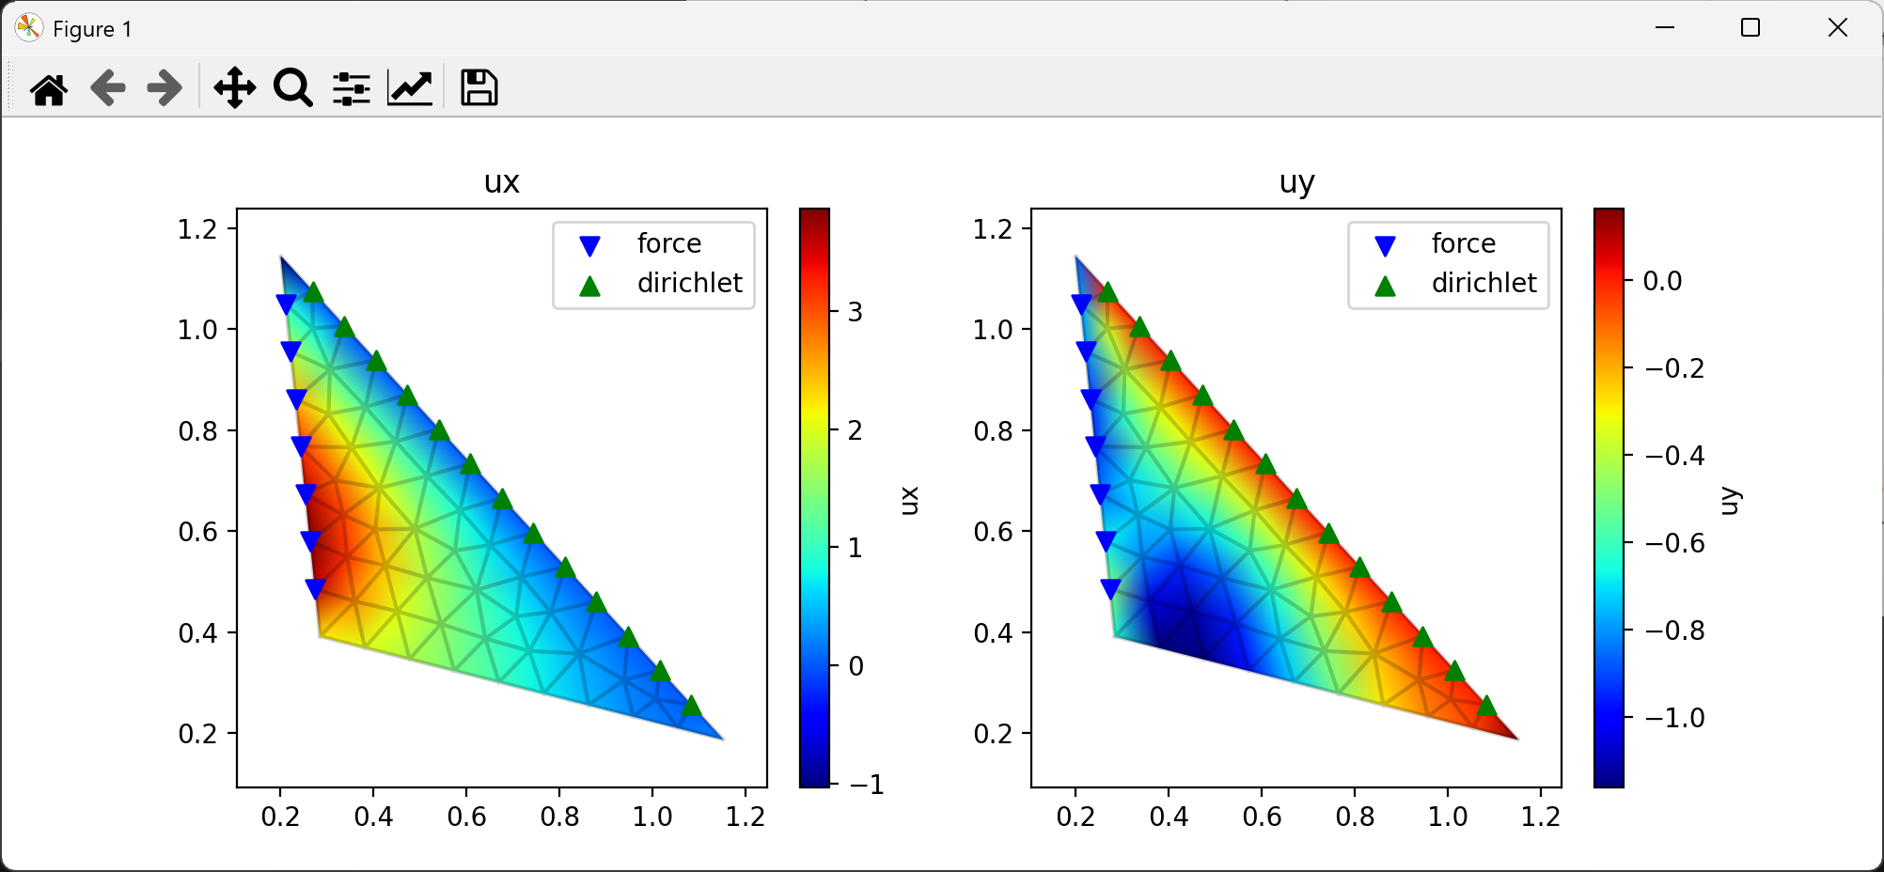
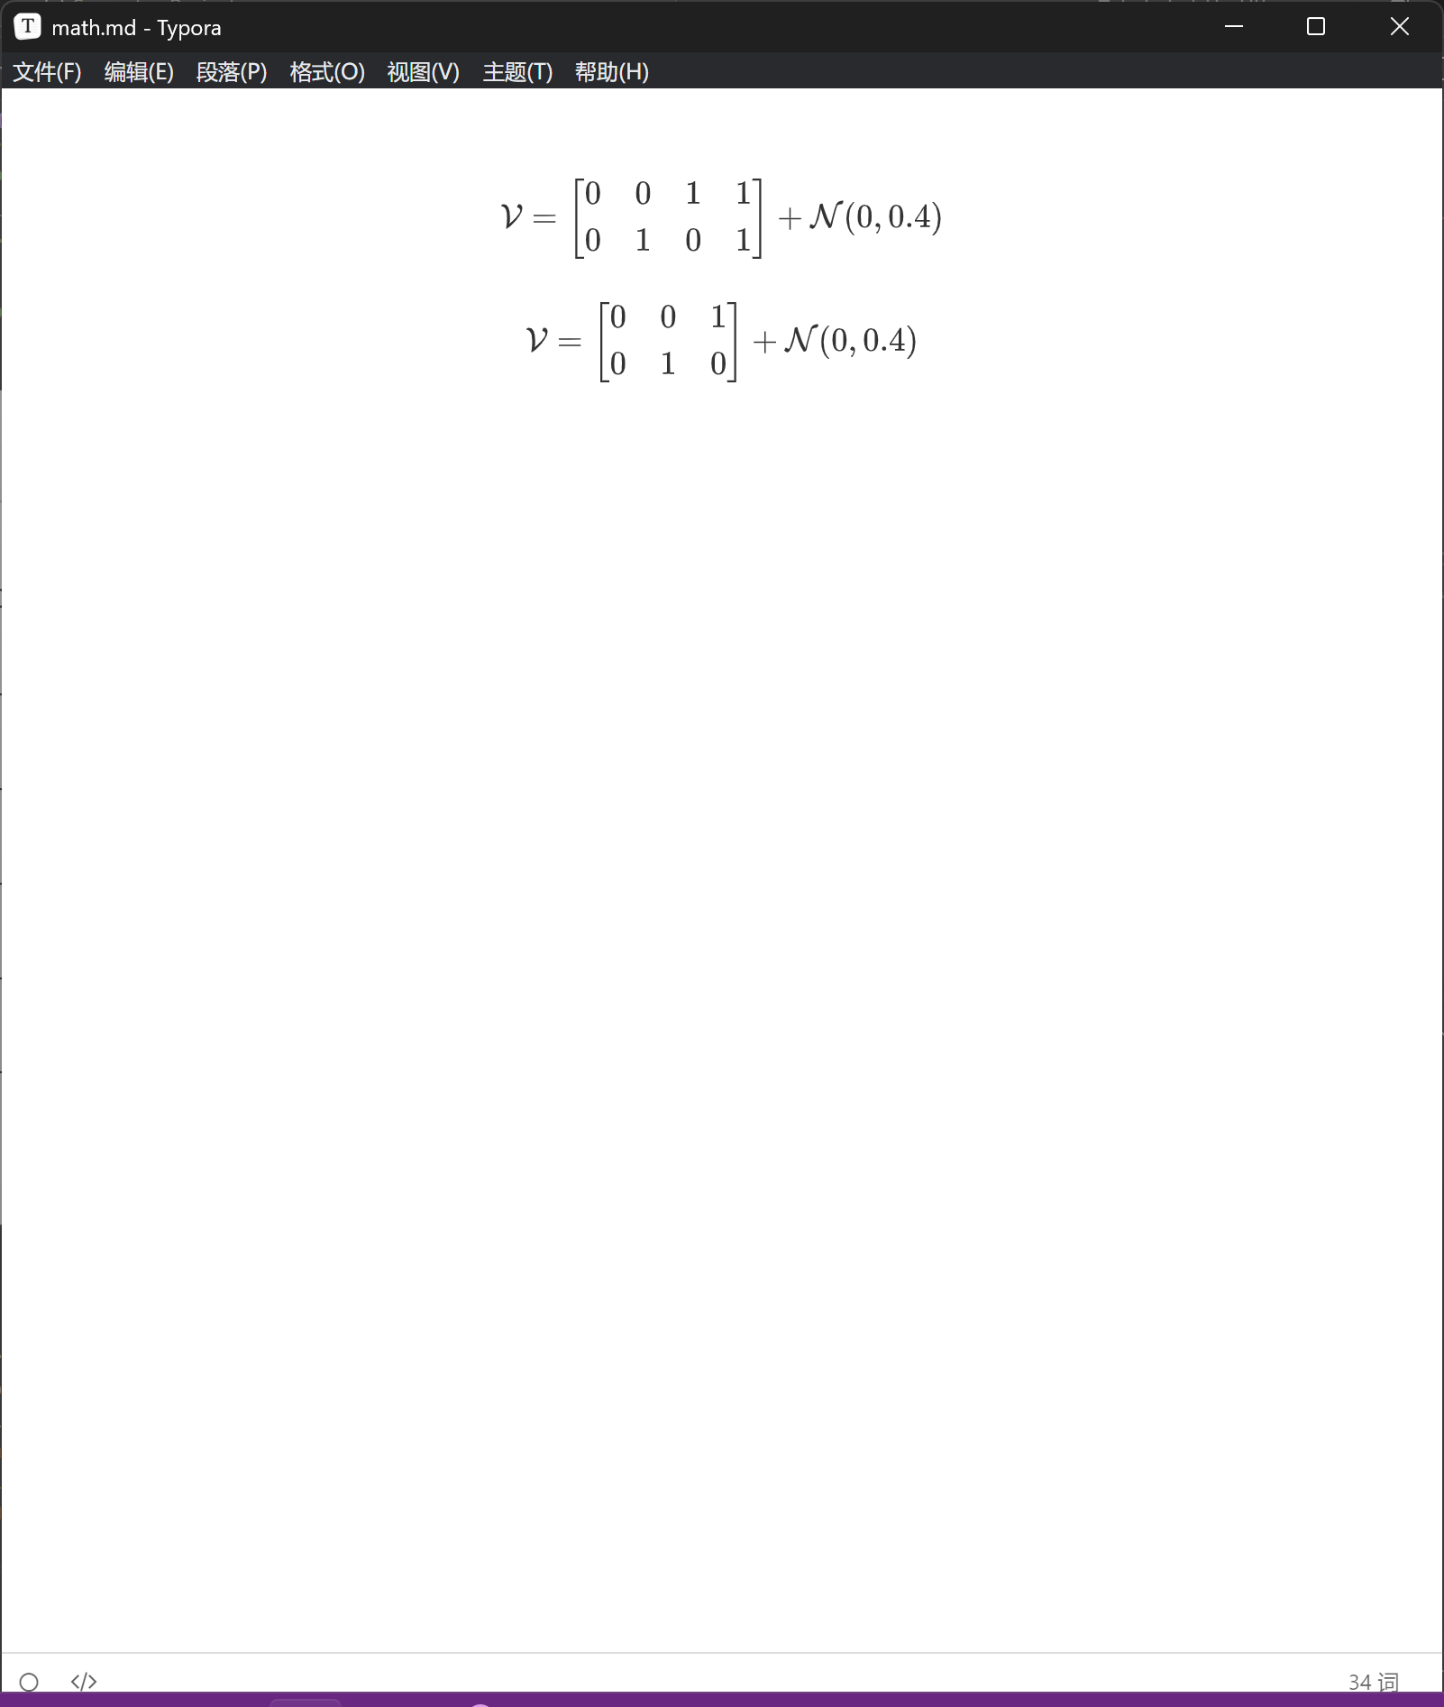
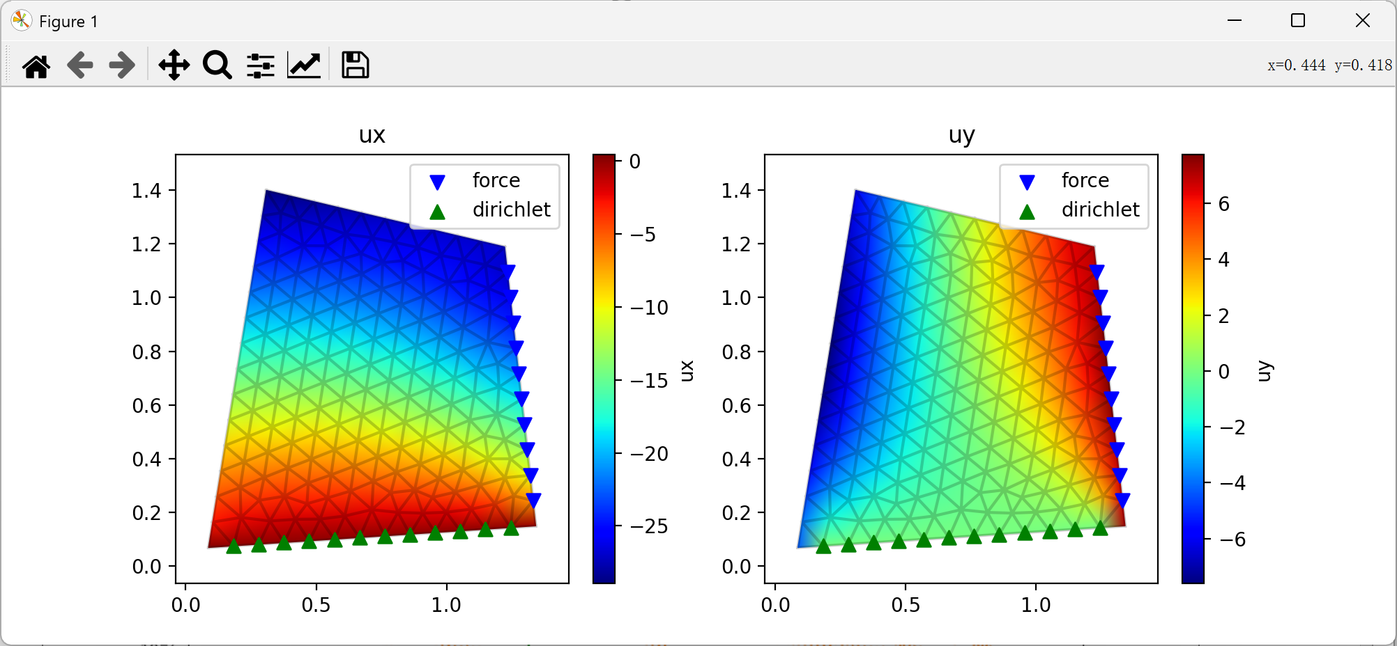
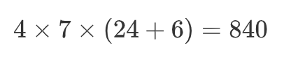
Experiments
Static Condense Equivelant Architecture(SCEA) : Generalization Dataset
B
A
C
C
B
D
A

Slide 25
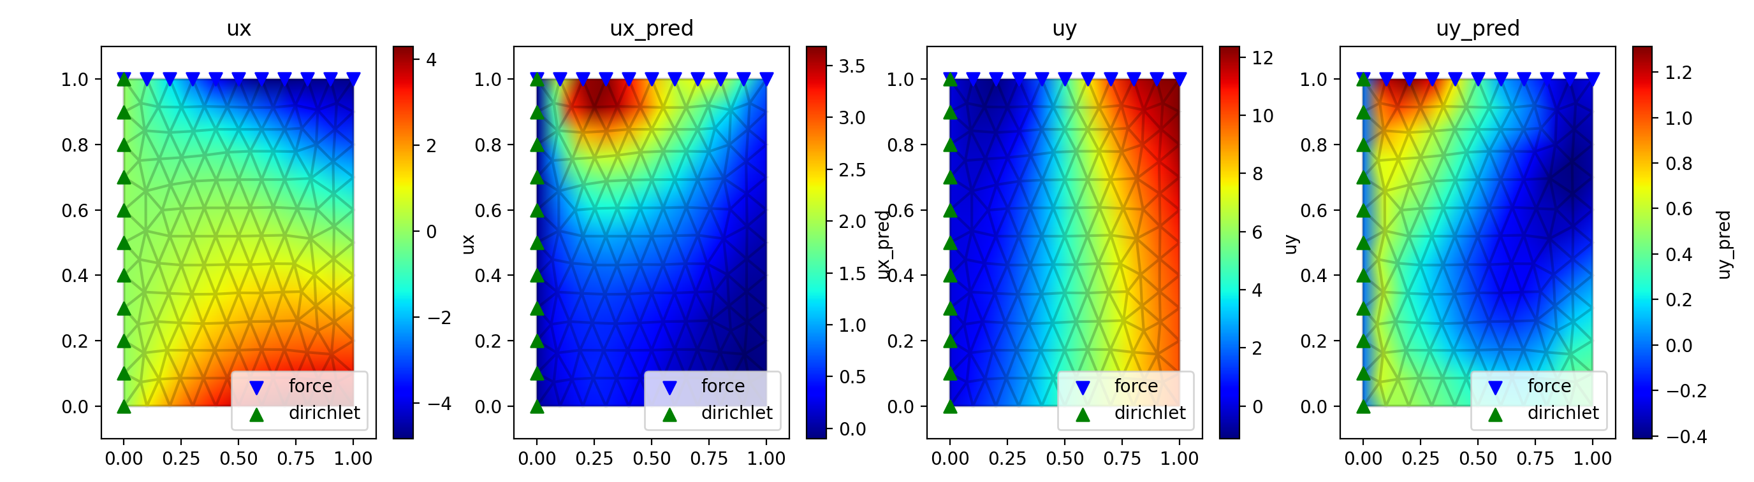
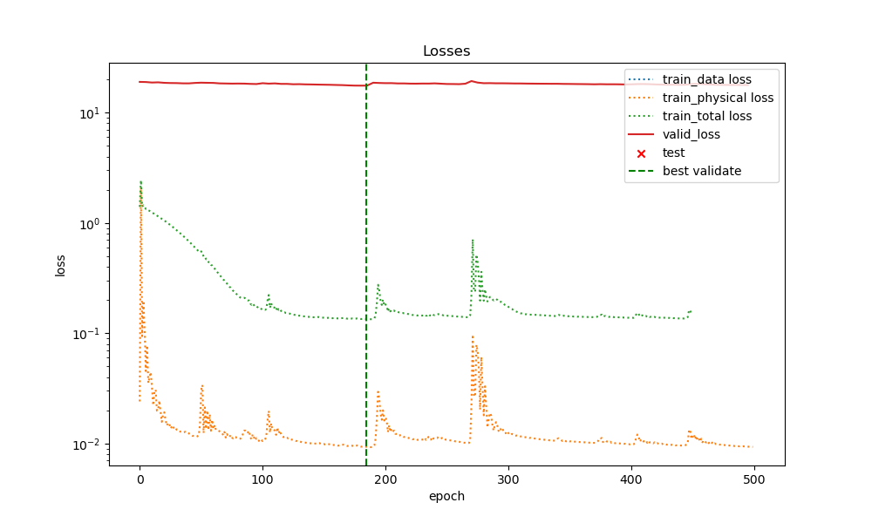
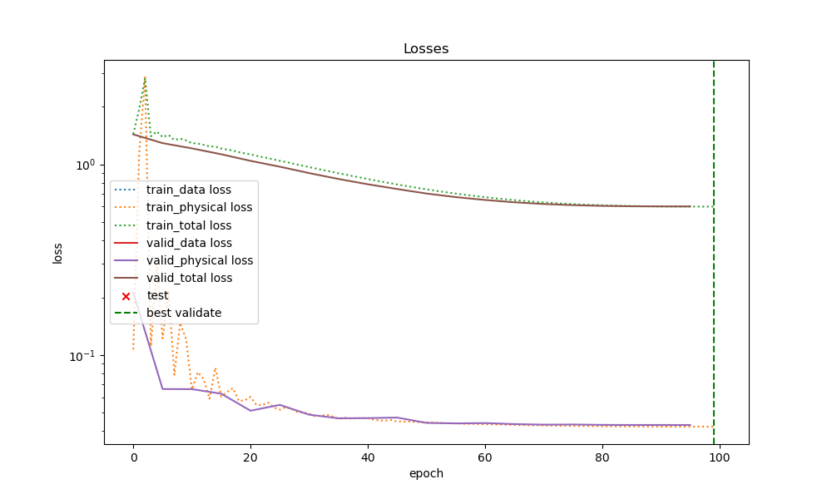
Experiments
Static Condense Equivelant Architecture(SCEA) : Generalization Result

Slide 26
Experiments
Static Condense Equivelant Architecture(SCEA) : Generalization Result

Slide 27
Experiments
Static Condense Equivelant Architecture(SCEA) : Generalization Result

Slide 28
Experiments
Static Condense Equivelant Architecture(SCEA) : Generalization Result

Slide 29
Experiments
Static Condense Equivelant Architecture(SCEA) : Generalization Result
Multi Graph physical loss training still cannot perform well on generalization for data loss
It may because of the disadvantage of PINN (physical loss is gradient instead of the function itself)
Notes:
In detail
Pinn disadvantage in detail

Slide 30
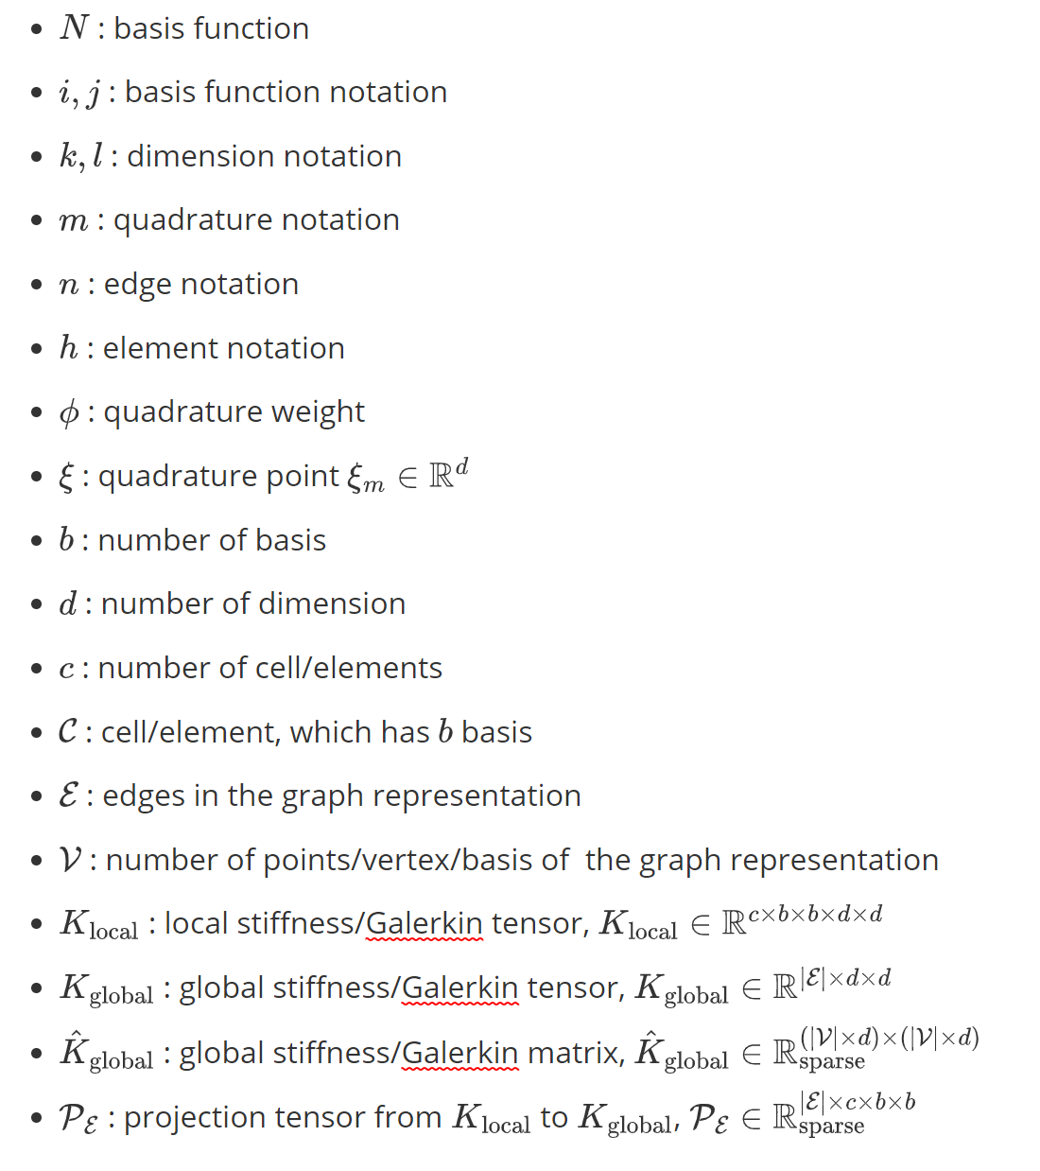
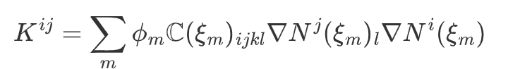
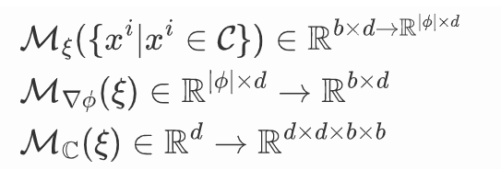
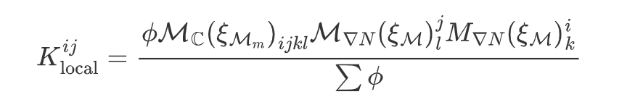
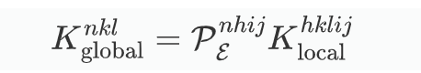

Methodology
Galerkin Equivelant Architecture (GEA) : Pseudo Bilinear

Slide 31
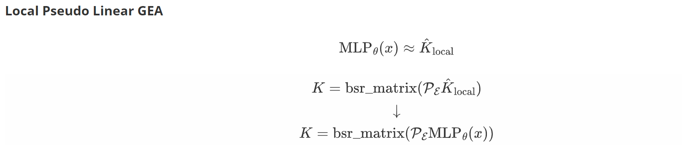
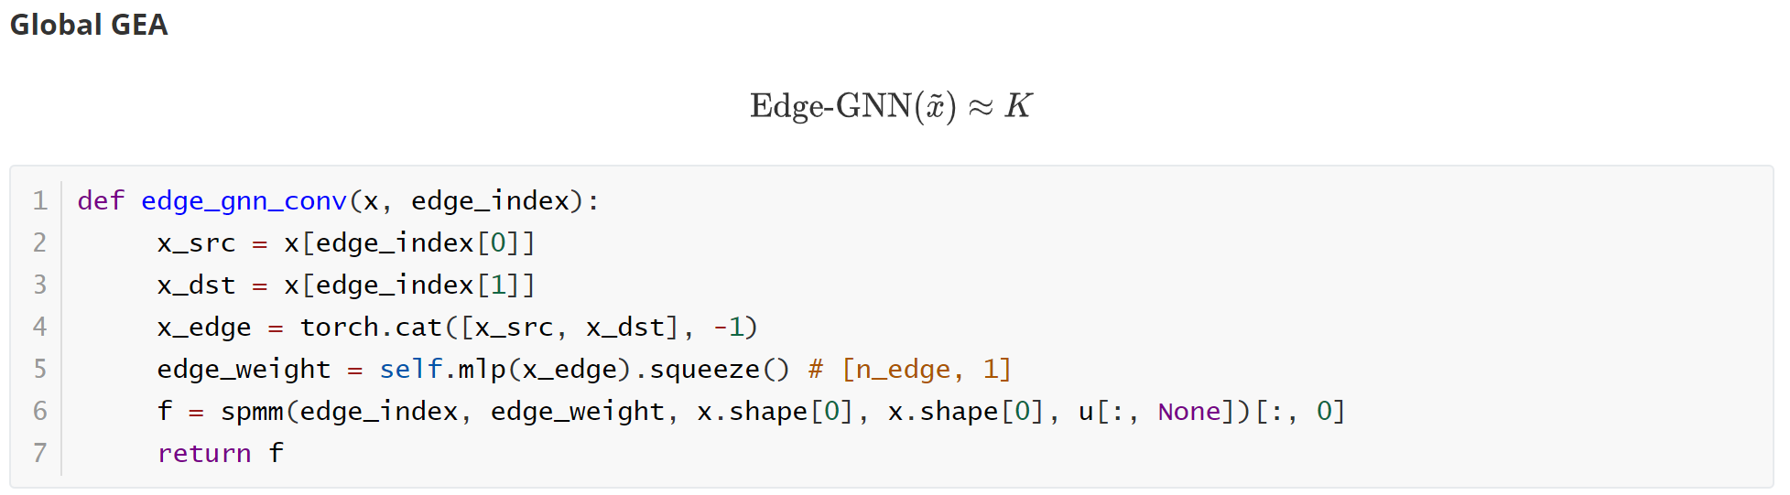
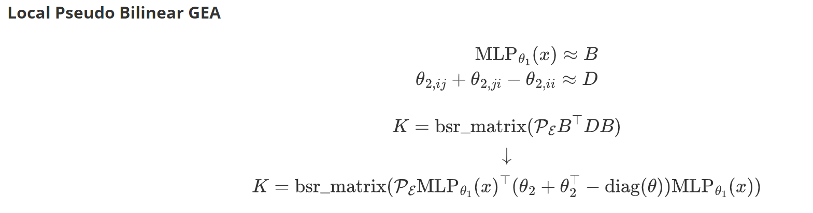
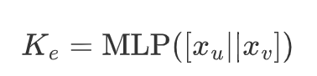
Methodology
Galerkin Equivelant Architecture (GEA)

Slide 32







Experiments
Galerkin Equivelant Architecture (GEA)
Local Pseudo Bilinear
Local Pseudo Linear
Global
Notes:
Blue box – Galerkin matrix
Ground truth - prediction

Slide 33
Experiments
The parameter space is too large and not smooth in matrix
The local pseudo linear seems better
Notes:
In detail

Slide 34
Conclusion
Propose Static Condensation Equivalent Architecture to find the equivalence in reverse problem
Propose Galerkin Equivalent Architecture to find the equivalence in forward problem
Propose a differentiable fast assemble method
Experiments to investigate the effectivness and generalization of the phy loss
Physical Loss can do well on minimizing the data loss on single dataset
Physical Loss can hardly minimizing the data loss for bunch of datasets(generalization)
Galerkin prediction is hard to achieve, since large parameter space
Notes:
goal
Summerize what I did

Slide 35
Thank you
for your
attention
Mingyuan Chi
Semester Project
minchi@student.ethz.ch
ETH Zürich
Department of Mathematics
Computational Science and Engineering

Slide 36


Appendix
Static Condense Equivelant Architecture(SCEA) : Generalization Dataset
50% nodes Test (data)
50% nodes Valid (phy)
100% nodes Train (phy)
graph1 | graph2 | graph3 | graph4 | graph5 | graph6

Slide 37



Appendix
Galerkin Equivelant Architecture (GEA)
Local Pseudo Bilinear
Local Pseudo Linear
Global

